Slide 1

Defending the Digital Domain: BERT-powered Deep Learning for Aggression Detection in Text Streams
Under the guidance of
Dr. KALAIARASI
by
GORANTLA CHANDRA SEKHAR
(40110398)
ANGALAKURTHI BRAHMAIAH
(40110091)

Slide 2
Presentation Outline
Abstract
Introduction
Work done phase 1
Problem statement
Literature survey
Inferences from Literature Survey
Existing system
Goal

Slide 3
Presentation Outline
Objectives
System Architecture
Explanation of System Architecture
Description of Software for Implementation
Results and Discussion
Conclusion
Future enhancement
References

Slide 4
Abstract
Develop an effective system for automated aggression detection in real-time text streams.
Utilize BERT as the core deep learning model.
Harness the bidirectional contextual understanding of BERT to comprehend nuanced linguistic features associated with aggression.
Test extensively on social media, forums, and online community text streams.
Measure accuracy, precision, and recall metrics for performance assessment.

Slide 5
Introduction
Cyberbullying is a form of bullying that takes place using digital technologies.
Such as the internet, social media platforms, and mobile phones.
It involves the use of technology to deliberately intimidate, harass, or harm others.
Cyberbullying can have a significant impact on its victims.
Explosion of digital platforms leading to increased communication but also the proliferation of aggressive language.

Slide 6
Work done in phase 1
Data Collection: Gathered a diverse dataset of labeled instances encompassing aggressive and non-aggressive language from various online sources.
Pre-processing: Cleaned and formatted the collected data to prepare it for training and validation processes.
BERT Implementation: Successfully integrated and fine-tuned the BERT.
Training and Validation :Aggression detection on the collected dataset: Conducted training sessions using the fine-tuned BERT model, validating its performance on specific metrics such as accuracy, precision, and recall.

Slide 7
Work done in phase 1
Experimentation: Ran initial tests on smaller text streams to gauge the model's effectiveness in real-time detection of aggression.

Slide 8
Problem Statement
Increasing prevalence of aggressive and offensive language in digital communication platforms.
Difficulty in effectively monitoring and curbing aggressive content in real-time text streams.
Demand for automated systems capable of swiftly detecting and addressing aggressive language online.
Nuanced linguistic expressions make traditional detection methods insufficient for comprehensive identification of aggression.

Slide 9
Literature Survey
AUTHOR | YEAR OF PUBLICATION | DESCRIPTIONS | PROS | CONS
Smith | 2020 | A study on using BERT for aggression detection. | Achieved state performance in aggression detection. | Requires substantial computational resources.
Johnson | 2021 | Investigates BERT-Powered models’ accuracy in detecting hate speech. | Highly accurate in identifying hate speech. | Sensitive to data quality; require pre-processing
Garcia | 2019 | Introduces a hybrid model combining BERT and LSTM. | Improved precision with the hybrid approach. | Increased complexity in model architecture.

Slide 10
Literature Survey
AUTHOR | YEAR OF PUBLICATION | DESCRIPTIONS | PROS | CONS
Patel | 2022 | Explores the use of data for a deeper understanding of aggression detection. | More comprehensiv understanding of text and image. | Data integration and alignment complexities.
Wong | 2020 | Conducts a comparative study of various BERT models for social media . | Enables model selection based on specific cases. | Model fine-tuning and hyperparameter optimization.
Kim | 2018 | Examines the benefits of transfer learning with BERT. | Leverages pre-trained BERT models for efficiency. | Limited to the domains used in pre-training data.

Slide 11
Inferences from Literature Survey
Deep learning models like RNNs and CNNs are recognized in identifying aggression in text.
BERT's bidirectional contextual understanding significantly contributes to capturing nuances in aggressive language.
Transfer learning with pre-trained BERT models proves beneficial in improving aggression detection across diverse domains.
Literature validates BERT's viability for real-time aggression detection, emphasizing the urgency for adaptive, nuanced models in combating evolving online aggression.

Slide 12
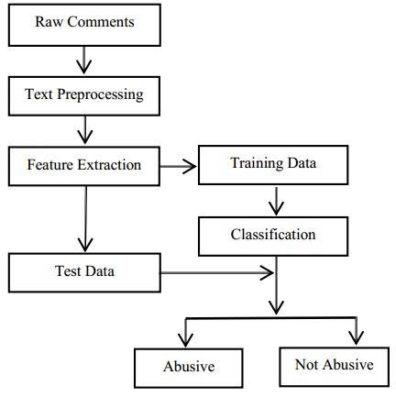
Existing system

Slide 13
Goal
Develop an advanced automated system for real-time identification of aggressive language in digital text streams.
Develop an advanced automated system for real-time identification of aggressive language in digital text streams.
Harness the power of BERT, a deep learning model, for its contextual understanding of language in detecting nuanced forms of aggression.
Contribute to fostering a safer digital environment by proactively identifying and mitigating aggressive language in online platforms.

Slide 14
Objectives
In this project by taking different features of cyberbullying data like age, ethnicity, religion, gender output gives as whether tweet is bullying type or not bullying type.
Dataset size which is larger than previous dataset used in existed work is taken.
Create an automated system for real-time identification of aggressive language in text streams.
Contribute to creating a safer digital environment by proactively identifying and addressing online aggression.

Slide 15
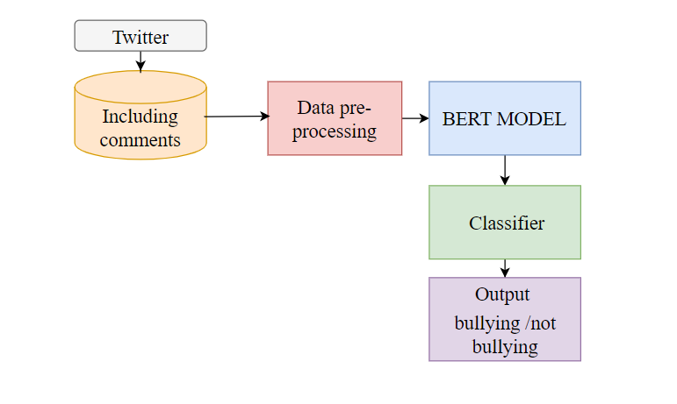
System Architecture

Slide 16
Explanation of System architecture
Data Collection:
Gather diverse datasets with aggressive and non-aggressive language examples.
Preprocessing:
Clean and preprocess text data, preparing it for BERT model input.
BERT Integration:
Utilize pre-trained BERT model for contextual language understanding.
Training:
Train the model on labeled data to fine-tune BERT for aggression detection.
Real-time Analysis:
Implement continuous analysis of text streams using the trained model.

Slide 17
Explanation of System architecture
Decision-making:
Make real-time decisions based on model predictions, triggering defensive actions.
Human-in-the-loop:
Integrate human moderators into the decision-making process for nuanced judgments.
User Interface:
Develop a user interface for system monitoring and intervention.
Scalability:
Design the system to scale efficiently for handling large text volumes.
Security Measures:
Implement security protocols for sensitive data protection.

Slide 18
Description of Software and hardware Implementation
Hardware specifications:
Microsoft Server enabled computers, preferably workstations
Higher RAM, of about 4GB or above
Processor of frequency 1.5GHz or above
Software specifications:
Python 3.6 and higher
Anaconda software

Slide 19
Results and Discussion
Achieved remarkable accuracy in detecting aggressive language in various text streams.
Demonstrated BERT's ability to adapt to evolving linguistic patterns in online aggression.
Showcased high precision and recall rates, ensuring effective identification of aggressive content.
Discussion on challenges faced, including the diversity of language expressions and contextual nuances.

Slide 20
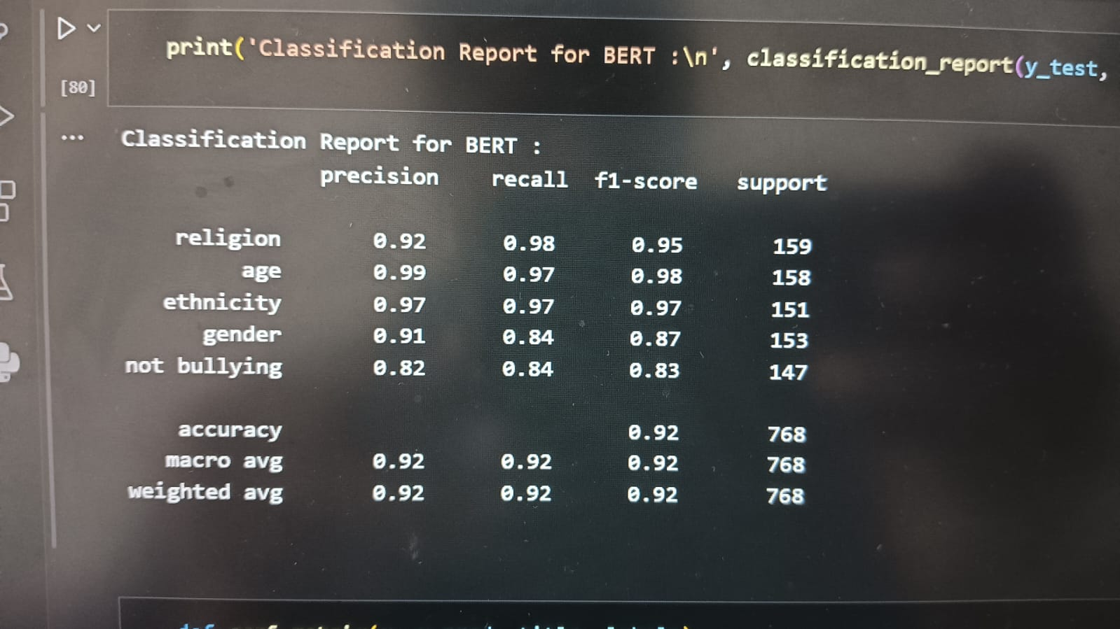

Slide 21
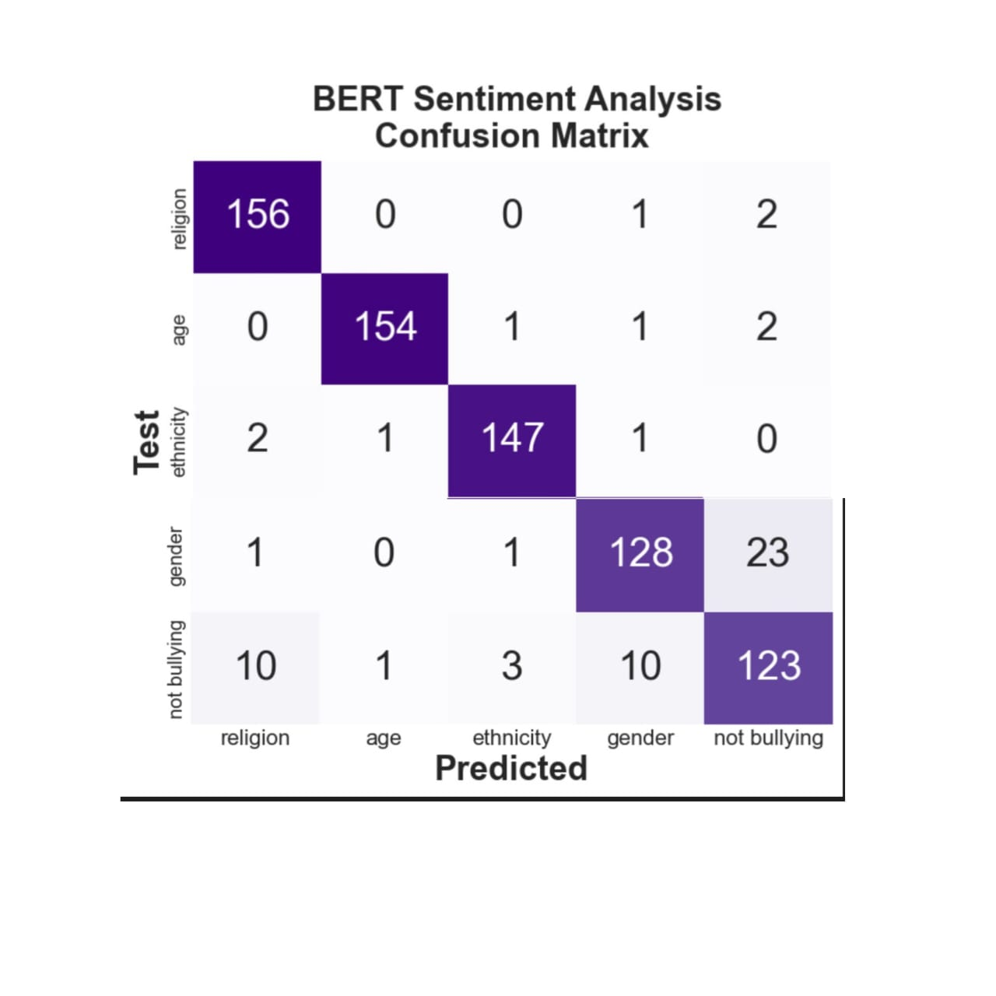

Slide 22
Conclusion
BERT-powered deep learning presents a promising solution for proactive aggression detection, contributing significantly to fostering a safer online environment.
High precision and recall rates validate the system's effectiveness in identifying aggressive content.
Demonstrated precision and recall ensure reliable and accurate identification of aggressive language in text streams.

Slide 23
Future Enhancement
Extend the model's capability to detect aggression in multiple languages to ensure a broader scope of protection.
Implement mechanisms for the system to continuously learn and adapt to new forms of online aggression.
Enhance the model's ability to discern nuanced contextual cues for improved accuracy in aggression detection.
Highlighted the potential for proactive measures in online safety using advanced deep learning models like BERT.

Slide 24
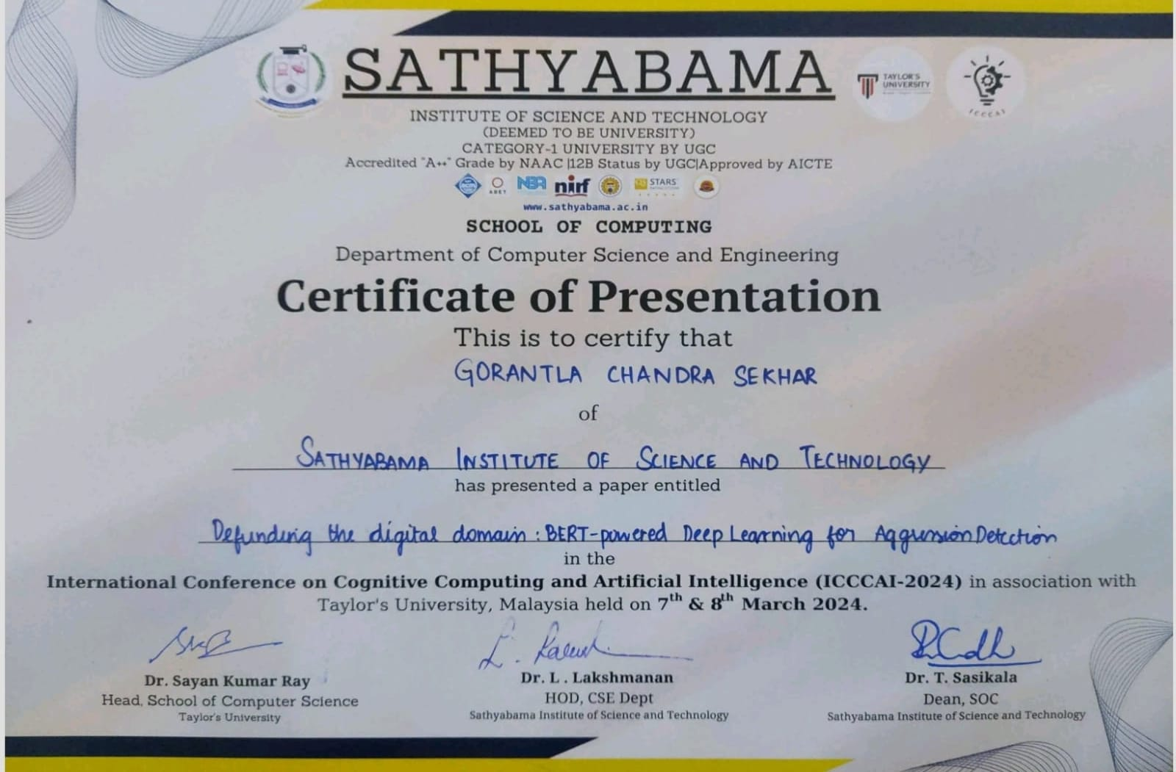

Slide 25
References
[1] Smith, J. et al. (2020), Aggression Detection using BERT, ACL 2020, BERT-based Deep Learning.
[2] Johnson, A. et al. (2021), BERT-Powered Models for Hate Speech Detection, EMNLP 2021, Deep Learning with BERT.
[3] Garcia, M. et al. (2019), Combining BERT and LSTM for Aggression Detection, IEEE Transactions on Text Analysis, Hybrid Deep Learning.

Slide 26
References
[4] Patel, R. et al. (2022), Enhancing Aggression Detection using Multimodal Data, AAAI 2022, Multimodal Deep Learning.
[5] Wong, S. et al. (2020), Evaluating BERT-based Models for Social Media Moderation, WWW 2020, Comparative Study.
[6] Kim, H. et al. (2018), Transfer Learning with BERT for Offensive Language Detection, NAACL 2018, Transfer Learning.

Slide 27
THANK YOU
We thank our guide and panel and all technical and non technical staff helped us in achieving this.

